Slide 1

Restaurant Management System.
Krishna Engineering
College

Slide 2

Submitted By:-
1. Deepak Kumar
2. Kumari Shikha.
3. Abhishek Mittal.
4. Shourabh Rathi.

Slide 3
Contents
1. Introduction
1.1 Purpose
1.2 Scope
1.3 Technology Used
1.4 Overview
1.5 Functionality
2. Feasibility Study
3. Problem Statement
4. Solution Statement
5. Data Flow Diagram
6. Future Scope
7. Conclusion

Slide 4
Introduction:-
1.1 Purpose:-
The main focus of the project was to create a single working “point of management” restaurant system that acts as both a
terminal for taking orders and a terminal for generating reports and making changes to employees or items on the menu.
Project planning was done to define the scope of the project, assess risks, and estimate and schedule project activities and
thereby lay the foundation for the execution, monitoring and control of the project.
Operator :
Can enter details.
Can check types foods.
Can updates their profile.
Can comment for any Query.
Can gave rating to food.

Slide 5
1.2 Scope:-
Major software functions of the restaurant management system include managing orders, inventory, and employee
records, and generating reports.
Order management includes creating and deleting orders, adding and removing items from an order and closing orders. Orders should also be stored in the database to be used to calculate total sales. Inventory management includes adding
new products, deleting products and updating products and resources.
The software is responsible for a number of other functions. Our software must be able to add employees, edit their
information, and remove employees from the employee database. Menu items must be added, edited, and deleted
from the menu item database. Items that can be ordered must be able to be added and removed from an order.
All employees must be able to clock in and clock out. Servers must be able to do what all employees do as well as take
orders. Managers should be able to do what all employees do and be able to edit item and employee information and
generate reports. Reports that should be generated include sales reports showing sales by food category and the total
sales from the start of the day. Orders should also be stored in the database to be used to calculate total sales.
.

Slide 6
1.3 Technology Used :-
Programming languages:
JAVA EE: Java Enterprise Edition is a programming platform— part of the Java Platform-for developing
and running distributed multi-tier architecture Java applications, based largely on modular software
components running on an application server.
HTML: Hyper Text Markup is the predominant markup language for web pages. It provides a means to
describe the structure of text-based information in a document and to supplement that text with
interactive forms, embedded images, and other objects.
JSP: A Client-side scripting language used to create dynamic web content and user interface.
MySQL: The data of this application can be stored in the database.
1.4 Overview : -
Project is related to Restaurant Management which provides to search a food and book table.
Any person can become a user by filling a prescribed form.
1.5 Functionality : -
Restaurant Management System.
Comments for any issues
User rating system.

Slide 7
2. Feasibility Study:-
In feasibility study phase we had undergone through various steps which are describe as under :
Identify the origin of the information at different level.
Identify the expectation of user from this system.

Slide 8
3. Problem Statement:-
Nowadays, in a highly technological society, human productivity is made more efficient through the development of
electronic gadgets" Technologies are important and helpful in everyone’s life" with when systematically arranged in
a room of private home for such collection the advance of such modernization in Restaurant System, one way to
globalize the process of research is to realize that technology is advancing at an incredibly fast pace “A Restaurant
System is providing a facility in which any operator or user can gather menu details and also book the table.
"Generally, what we see today is that to book a table is difficult because of unknown about Restaurant”.

Slide 9
4.Solution Statement:-
PROPOSED SYSTEM :-
There will be three major components :
Data Feeding via Customers.
Updation Of Profile.
Comments On any Query .
Ratings.
Proposed system provides with following solutions :
It provides "better and efficient" service to customer.
Reduce the booking workload of customer.
Faster retrieval of information about the food items.
All details will be available on a click.

Slide 10
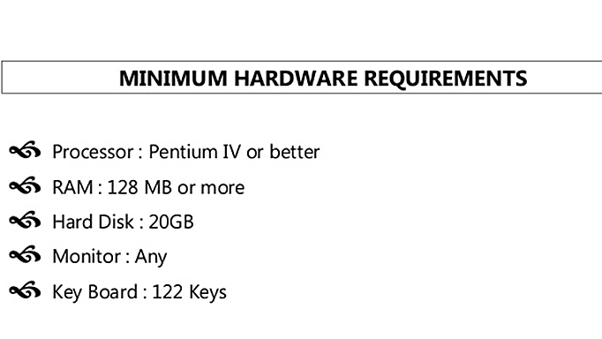

Slide 11
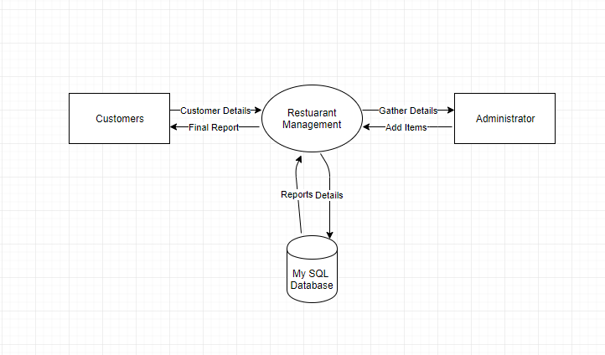
5. Data Flow Diagram (DFD):-

Slide 12
6. Future Scope :-
FUTURE SCOPE OF APPLICATION :
This application can be easily implemented under various situations. We can add new features as and when we require.
Reusability is possible as and when require in this application. There is flexibility in all the modules.
SOFTWARE SCOPE:
Extensibility: This software is extendable in ways that its original developers may not expect. The following principles enhances extensibility like hide data structure, avoid traversing multiple links or methods, avoid case statements on
object type and distinguish public and private operations.
Reusability: Reusability is possible as and when require in this application. We can update it next version. Reusable
software reduces design, coding and testing cost by amortizing effort over several designs. Reducing the amount of
code also simplifies understanding, which increases the likelihood that the code is correct. We follow up both types of
reusability: Sharing of newly written code within a project and reuse of previously written code on new projects.

Slide 13
Understandablity: A method is understandable if someone other than the creator of the method can
understand the code (as well as the creator after a time lapse). We use the method, which small and coherent
helps to accomplish this.
Cost-effectiveness: Its cost is under the budget and make within given time period. It is desirable to aim for
a system with a minimum cost subject to the condition that it must satisfy the entire requirement.
Scope of this document is to put down the requirements, clearly identifying the information needed by the user, the source of the information and outputs expected from the system.

Slide 14
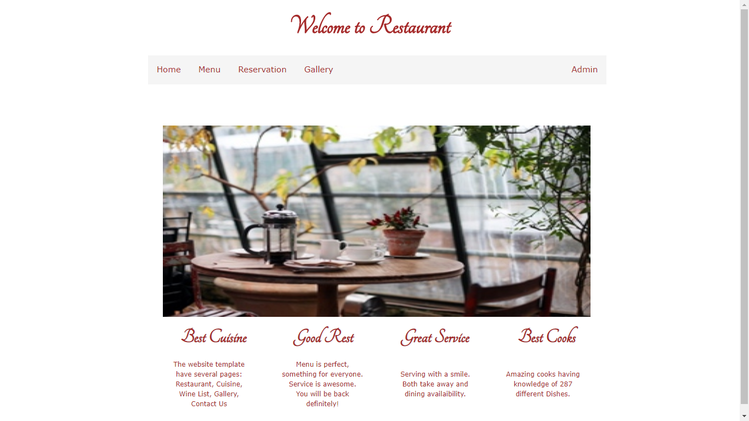
Home Page:-

Slide 15
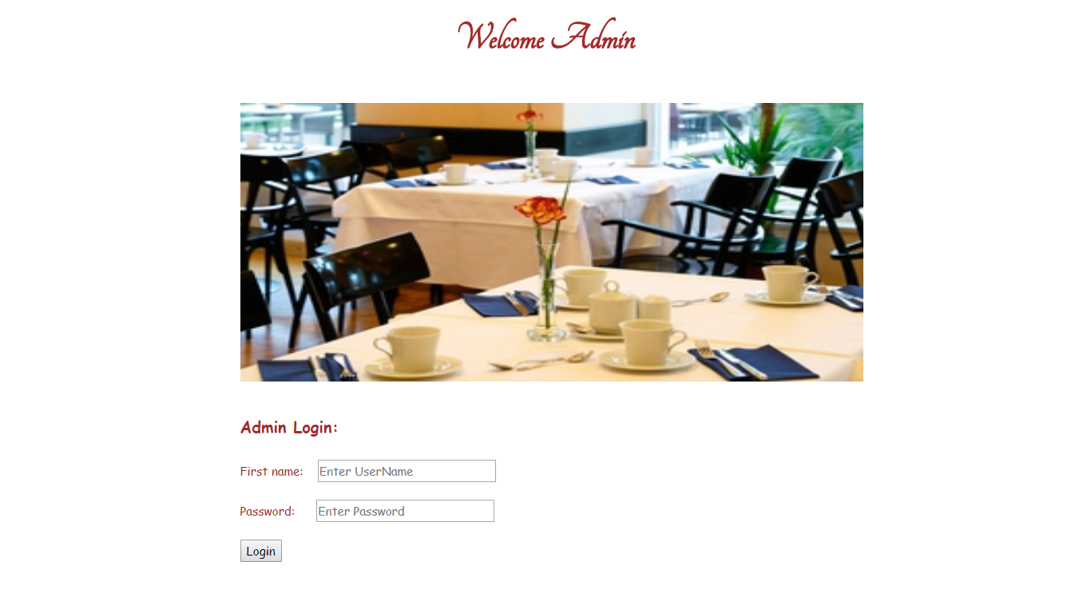
Admin page:-

Slide 16
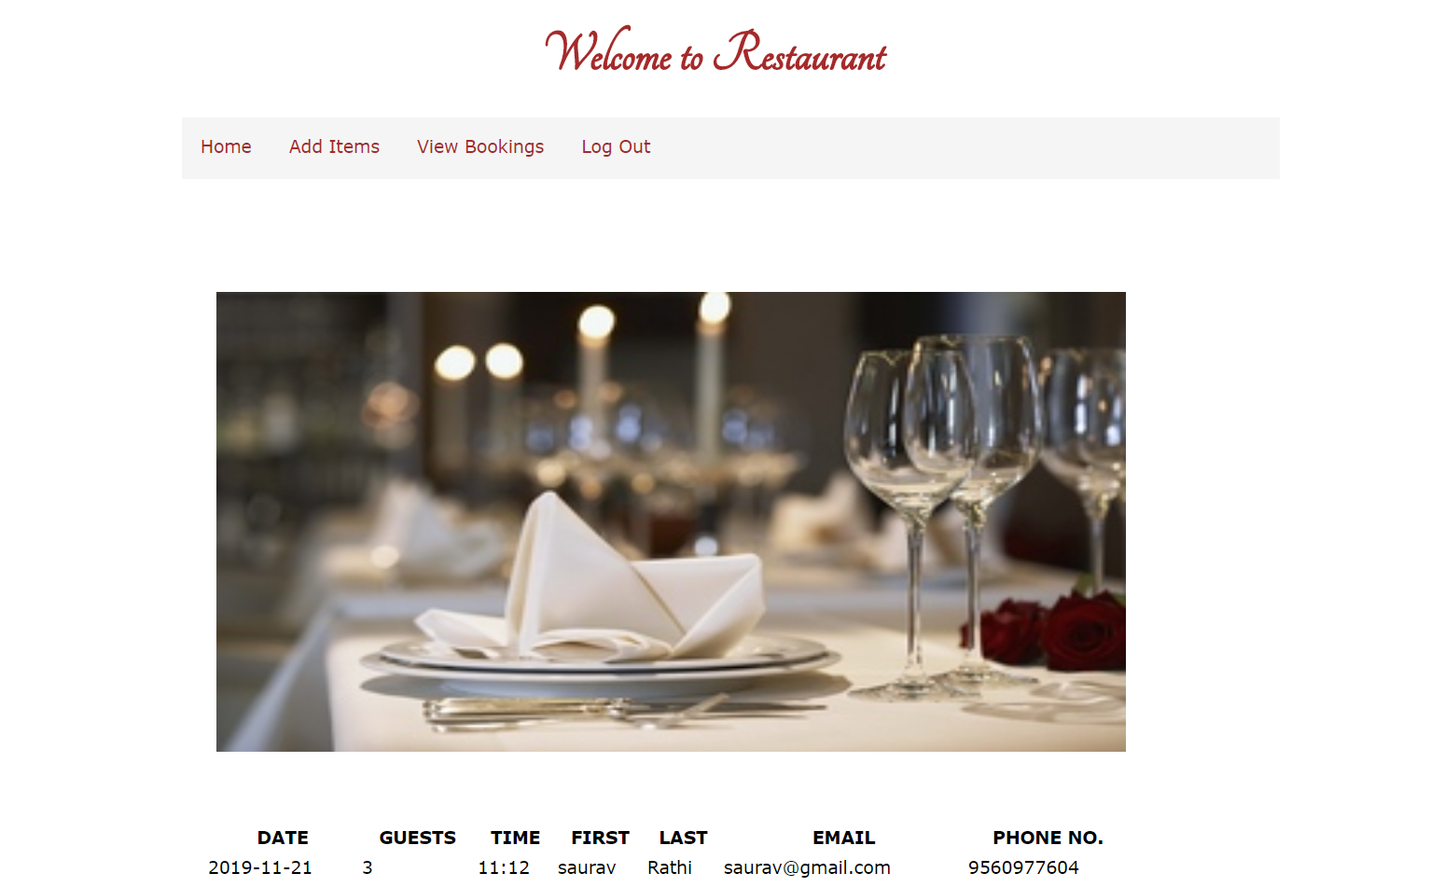
Admin page:-

Slide 17
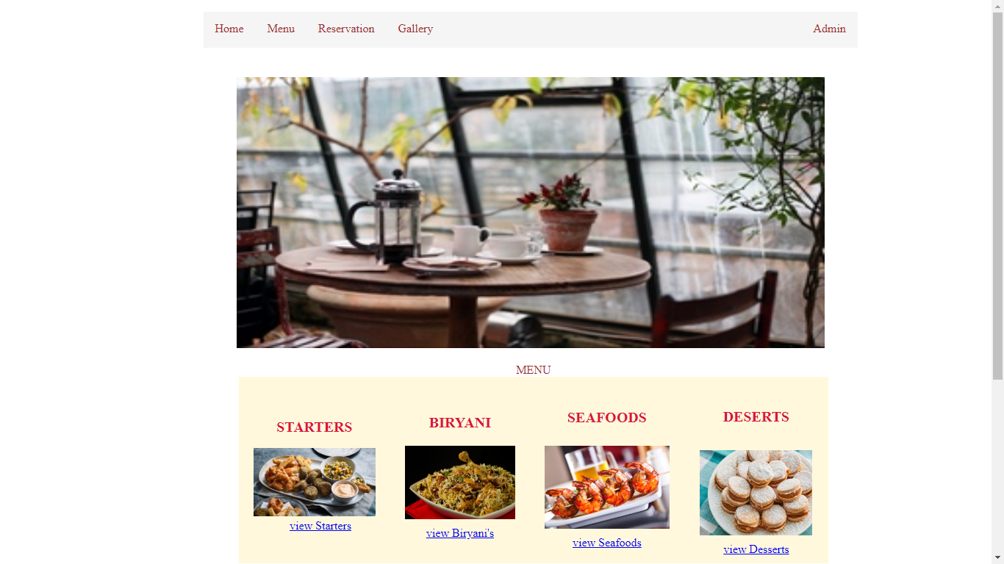
Menu page:-

Slide 18
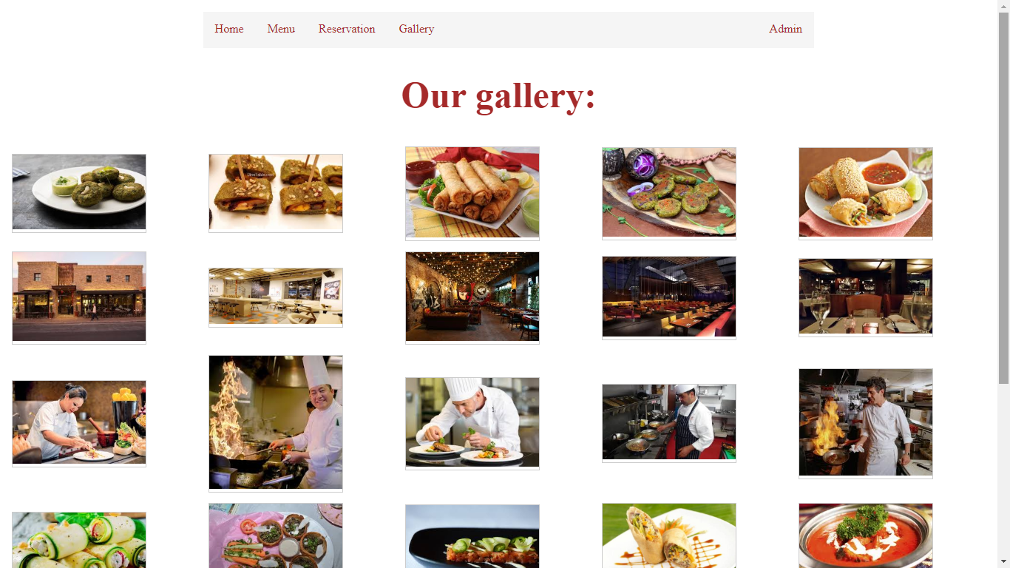
Gallery page:-

Slide 19
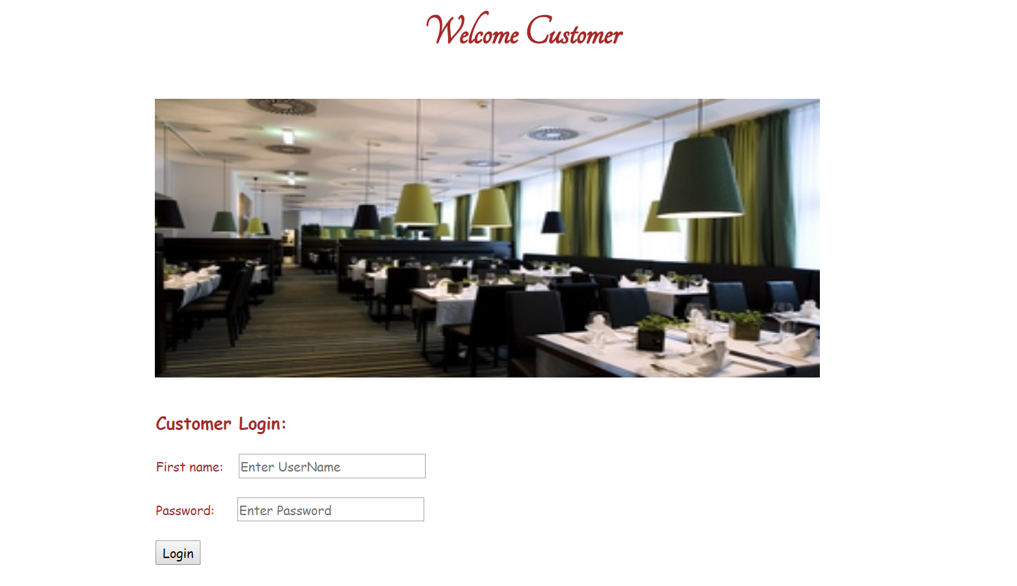
Gallery page:-

Slide 20
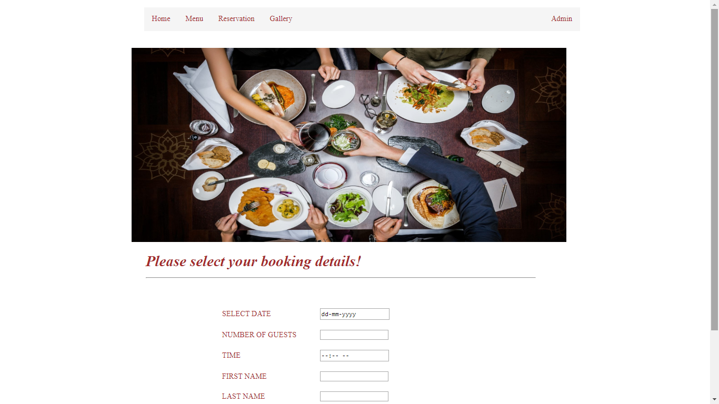
Reservation page:-

Slide 21
